Slide 1


Photodegradation of Onium Photoacid Generators under UV Irradiation: Identification and Evaluation of Photoproducts
Richard Pepel¹, Xi-Zhi Niu^{1,2,3}, Reyes Sierra-Alvarez¹, Leif Abrell^{2,3}, Eduardo Saez¹, Rodrigo Paniego¹, Jon Chorover^{2,3}, Jim A. Field¹
¹UNIVERSITY OF ARIZONA Department of Chemical & Environmental Engineering,
² ¹UNIVERSITY OF ARIZONA Department of Environmental Science,
³Arizona Laboratory for Emerging Contaminants, the University of Arizona

Slide 2
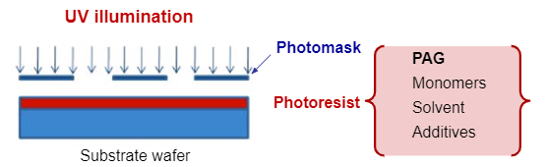
Background
  Onium salts (e.g. triaryl sulfonium, diaryl iodonium salts) are commonly used in semiconductor photolithography as photoacid generators (PAGs)
  They generate strong acids on UV irradiation, thereby promoting cationic polymerization reactions.
  However, the kinetics of photodegradation, fate, and the nature of the photodegradation products are poorly understood

Slide 3
Objectives
  Identify the characteristics of onium cations of PAGs
    Develop an analytical method for PAG cations
    Quantify the photolytic degradation of PAGs at 254 nm
    Identify the photoproducts of PAGs

Slide 4

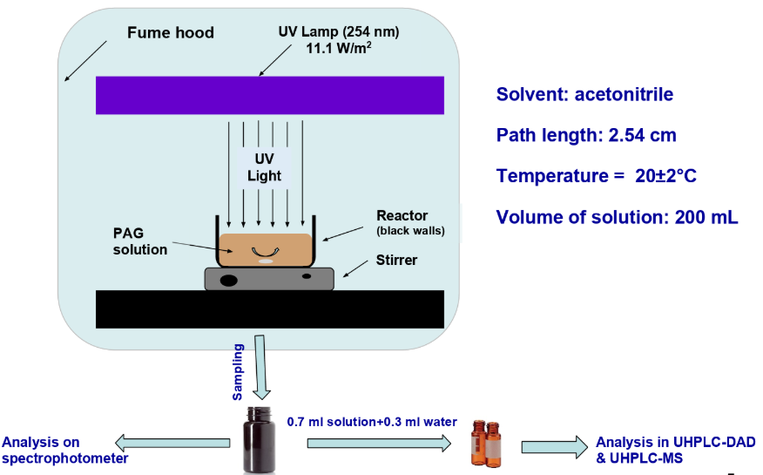
Photodegradation Set-up

Slide 5
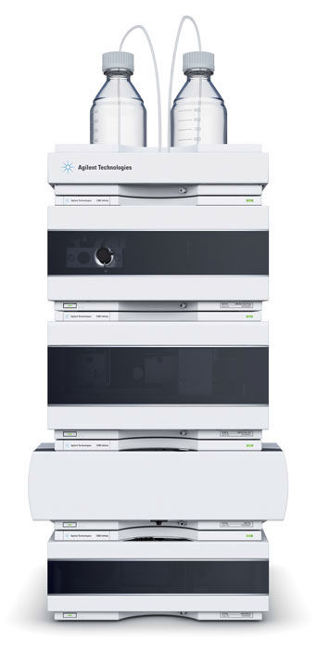
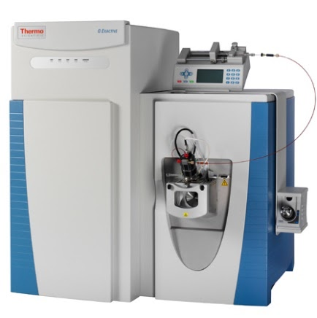
Procedure
  Photodegradation experiments were performed under 254 nm UV light
  Gas Chromatography-Mass Spectrometry (GC-MS) and High Performance Liquid Chromatography with Diode Array Detector (HPLC-DAD) were used to quantify onium concentrations and identify photoproducts

Slide 6
Example of a first-order degradation curve for a PAG cation
The rate constant ‘k’ is found using the slope of the integrated rate law for a first-order reaction:
ln[C] = -k•t + ln[C]₀

Slide 7
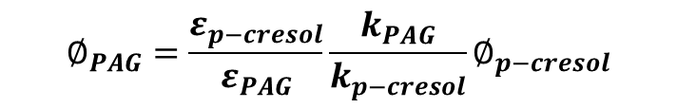
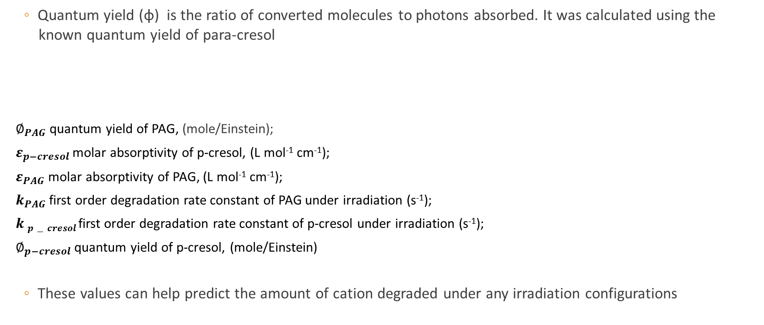
Quantum yield calculations
  Quantum yield (ɸ) is the ratio of converted molecules to photons absorbed. It was calculated using the
  known quantum yield of para-cresol
$∅_{PAG}$ quantum yield of PAG, (mole/Einstein);
$ε_{p−cresol}$ molar absorptivity of p-cresol, (L mol⁻¹ cm⁻¹);
$ε_{PAG}$ molar absorptivity of PAG, (L mol⁻¹ cm⁻¹);
$k_{PAG}$ first order degradation rate constant of PAG under irradiation (s⁻¹);
$k$ $p−cresol$ first order degradation rate constant of p-cresol under irradiation (s⁻¹);
$∅_{p−cresol}$ quantum yield of p-cresol, (mole/Einstein)
  These values can help predict the amount of cation degraded under any irradiation configurations
$$∅_{PAG}=\frac{ε_{p−cresol}}{ε_{PAG}}\frac{k_{PAG}}{k_{p−cresol}}∅_{p−cresol}$$

Slide 8
PAG photodegradation results
  Onium cations of the selected PAGs are found to be highly photochemically reactive
  Rapid photodegradation highlights importance of photoproducts
Onium PAG: | 1 | 2 | 3 | 4
k_{obs}(s⁻¹) | 1.25 ± 0.38 ×10⁻² | 1.23 ± 0.04 × 10⁻² | 4.50 ± 0.66 × 10⁻³ | 3.23 ± 0.05 × 10⁻³
t_{1/2} (s) | 51 ± 9 | 56 ± 2 | 154 ± 18 | 214 ± 3
ɸ (mole/einstein) | 0.62 ± 0.17 | 0.37 ± 0.01 | 0.23 ± 0.03 | 0.85 ± 0.01

Slide 9
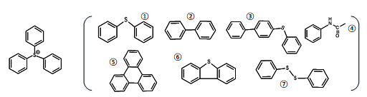
Example of Photoproducts of PAG cations as identified by HPLC-DAD and GC-MS.
Triphenyl sulfonium
photoproducts

Slide 10
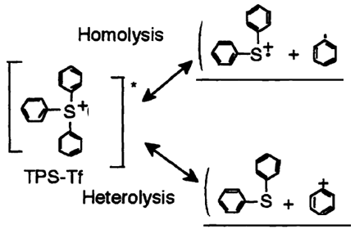
Photodegradation of Onium PAG cations: Degradation mechanisms
Photoproducts

Slide 11
Conclusions
  The model PAGs degrade readily when exposed to UV light at 254 nm.
  Photodegradation of the model PAGs produces apolar, aromatic products.

Slide 12
Acknowledgements
Thank you to the Arizona Space Grant Consortium
and to everyone involved in this project:
Xi-Zhi Niu^{1,2,3}, Reyes Sierra-Alvarez¹, Leif Abrell^{2,3}, Eduardo Saez¹, Rodrigo Paniego¹, Jon Chorover^{2,3}, Jim A. Field¹
¹Department of Chemical & Environmental Engineering,
²Department of Environmental Science,
³Arizona Laboratory for Emerging Contaminants, the University of Arizona
This was supported in part by the Semiconductor Research Corporation

